Slide 1
Three-phase transformer
Almost all major generation & Distribution Systems in the world are three phase ac systems.
Three phase transformers play an important role in these systems.
Transformer for 3 phase cct.s is either:
(a) constructed from 3 single phase transformers, or
(b) another approach is to employ a common core for
the three sets of windings of the three phases

Slide 2
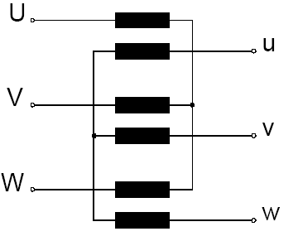
Three-phase transformer
A three-phase transformer consists of the interconnection of three single-phase transformers in Y– or Δ – connection.
This arrangement is mainly used in
the USA – in Europe only for high
power applications (>200 MVA)
because of transportation
problems. The combination in one
single three-phase unit instead of
three single-phase units is usual
elsewhere.

Slide 3
Three-phase transformer
The construction of a single three phase transformer is the preferred today, it is lighter, smaller, cheaper and slightly more efficient
There is an advantage that each unit in the bank could be replaced individually in the event of a fault, however this does not outweigh the other advantages of combined 3 ph. Unit.

Slide 4
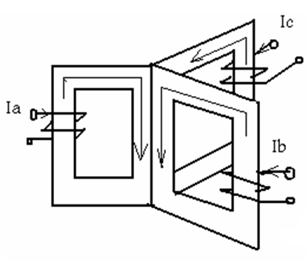
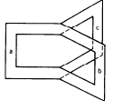

Three-phase transformer
φa+φb+φc=0
The magnetic return paths of the three cores can be dropped, which results in the usual type of three-phase transformers.

Slide 5
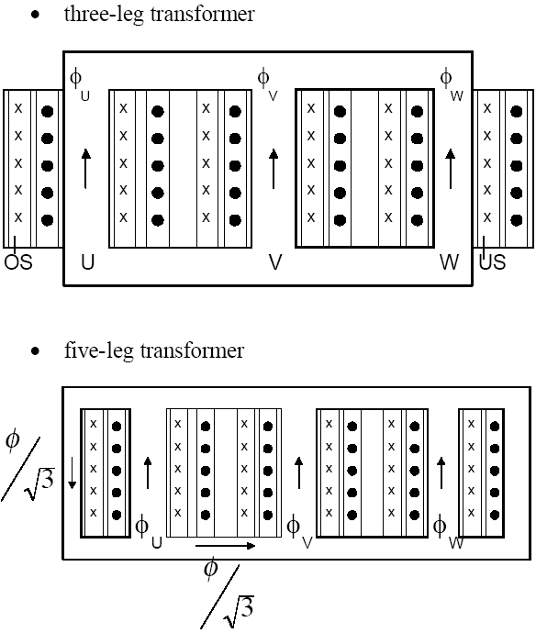
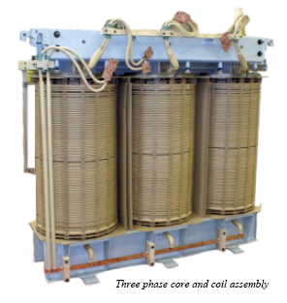
Three-phase transformer
Types of Construction
Three-phase transformers usually employ a three-leg core. Where transformers to be transported by rail are of large capacity, a five-leg core is used to keep them within the height limitation for transport

Slide 6
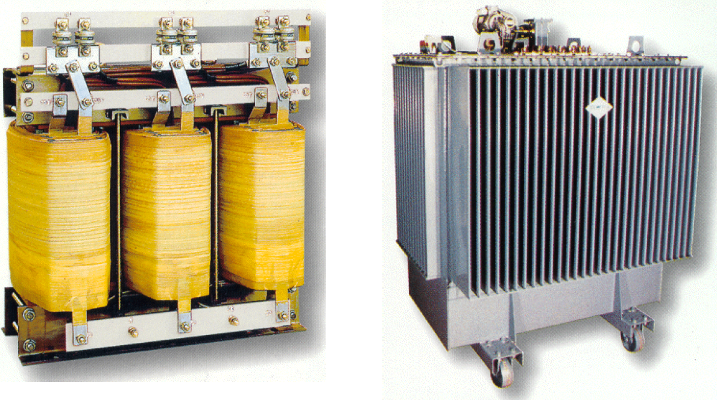
Three-phase transformer
Types of Construction

Slide 7
Three-phase transformer
Three-phase transformer connections
The windings of primary and secondary (in any construction) can be connected in either a wye (Y) or delta (Δ)
This provides a total of 4 possible connections for 3
phase transformer :
(a) Wye-wye Y-Y
(b) Wye-delta Y-Δ
(c) Delta-wye Δ-Y
(d) Delta-Delta Δ-Δ

Slide 8
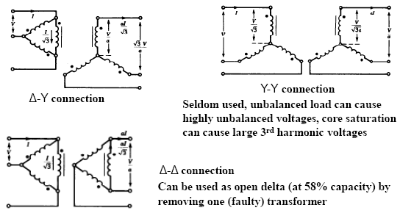
Three-phase transformer
Three-phase transformer connections

Slide 9
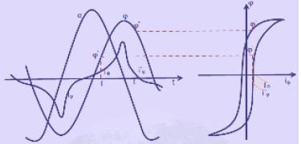
Three-phase transformer
Three-phase transformer connections
Harmonics in Transformers
For economic reasons (less iron, less space) the transformer is normally designed to operate in saturation region of the magnetic core.
The exciting current is non-sinusoidal with predominant third harmonic

Slide 10
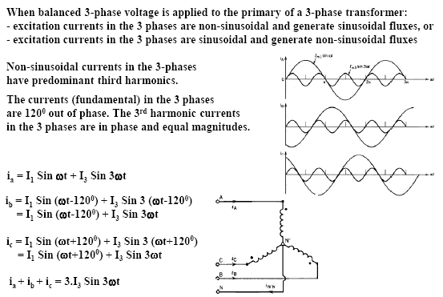
Three-phase transformer
Harmonics in Transformers

Slide 11
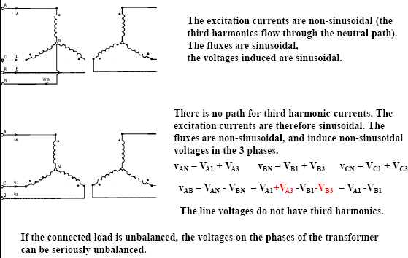
Three-phase transformer
Y-Y Transformer Connections & Harmonics
primary earth fault protection is not possible
Unbalanced flux in the transformer.

Slide 12
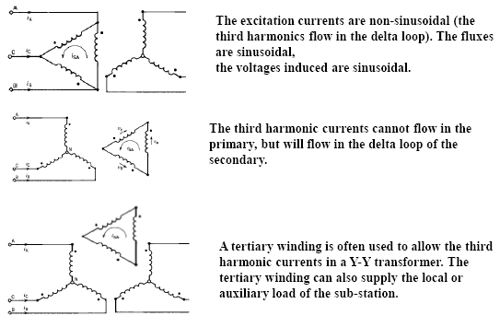
Three-phase transformer
Y- Δ Transformer Connections & Harmonics

Slide 13
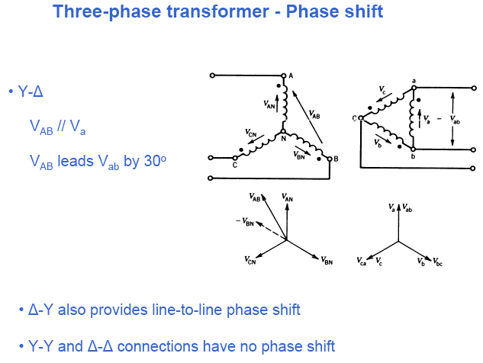

Slide 14
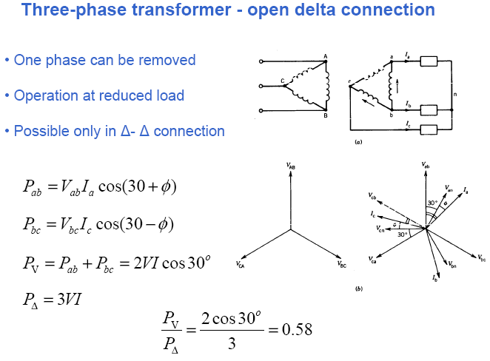

Slide 15
Three-phase transformer
Three-phase transformer connections
Star-Star (Y-Y) Connections. It gives line voltage √3 times phase voltage. It is economical for small high voltage transformers as the number of turns per phase and the amount of insulation required is less. There is no phase shift between primary and secondary voltages. The drawback is that the neutral is unstable because of third harmonic component in the exciting current.

Slide 16
Three-phase transformer
Three-phase transformer connections
Delta-Delta (Δ - Δ ) Connections. The arrangement is generally used in systems which carry large currents on low voltages and specially when continuity of service is to be maintained even though one of the phases develops fault. There is no phase displacement between primary and secondary voltages. There is no distortion of flux as the third harmonic component of magnetizing current can flow in the delta connected primary windings without flowing in the line wires. The conductor is required of smaller x-section as the phase current is 1/√3 times of the line current. No difficulty is experienced due to unbalancing of loads on the secondary side. The disadvantages are that more insulation is required and the voltage appearing between windings and core will be equal to full line voltage in case of earth fault on one phase.

Slide 17
Three-phase transformer
Three-phase transformer connections
Star-Delta(Y-Δ) Conections. Such connections are used principally where the voltage is to be stepped down, as for example, at the end of a transmission line. The neutral of the primary winding is earthed. In this system, line voltage ratio is 1/√3
Times of transformer turn-ratio and secondary voltage lags behind primary voltage by 30° . Also third harmonic currents flow in the to give a sinusoidal flux.

Slide 18
Three-phase transformer
Three-phase transformer connections
Delta-Star (Δ - Y) Connections. Such connections are used where it is necessary to step-up the voltage, as for example, at the beginning of a ht transmission line. In this case neutral point is stable and will not float in case of unbalanced loading. There is no distortion of flux because existence of a Δ -connection allows a path for the third-harmonic components. The line voltage ratio is √3 times of transformer turn-ratio and the secondary voltage leads the primary one by 30°. In recent years, this arrangement has become very popular for distribution system as it provides 3- Ø, 4-wire system.

Slide 19
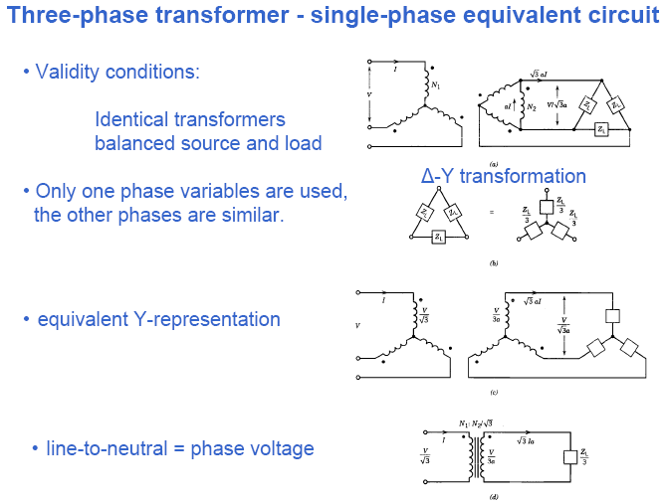

Slide 20

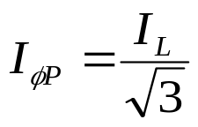
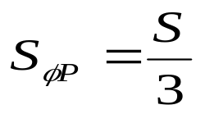
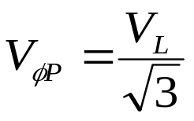

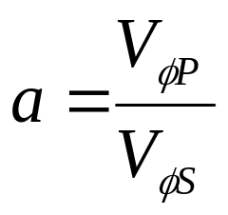
Three-phase transformer
Three-phase transformer analysis
Power circuits with 3-phase transformers can be analyzed using a per-phase
equivalent circuit when the system is balanced.
For a Delta configuration,
For Wye configuration,
The turns ratio:

Slide 21
Three Phase Transformers
WYE-DELTA CONNECTION
VLP=√3 VφP, while : VLS= VφS
Voltage ratio of each phase : VφP/ VφS=a
VLP/ VLS= √3 VφP/ VφS= √3 a ⬅ Y-Δ
DELTA-WYE CONNECTION
In Δ-Y primary line voltage is equal to primary phase voltage VLP=VφP, in secondary VLS=√3VφS
Line to line voltage ratio ; VLP/ VLS = VφP/ [√3 VφS ]=a/√3 ⬅ Δ-Y
DELTA-WYE CONNECTION
In Δ-Y primary line voltage is equal to primary phase voltage VLP=VφP, in secondary VLS=√3VφS
Line to line voltage ratio ; VLP/ VLS = VφP/ [√3 VφS ]=a/√3 ⬅ Δ-Y
DELTA-DELTA CONNECTION
In Δ-Δ connection VLP= VφP and VLS= VφS
Voltage ratio : VLP/VLS= VφP / VφS =a ⬅ Δ-Δ

